Slide 1
ASM for UAS Operations
ATS Coordination
Head of Airspace Management Department
Federal Air Transport Agency
Yury Tokarev

Slide 2
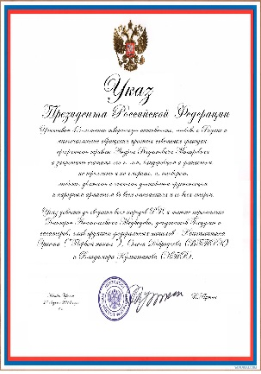
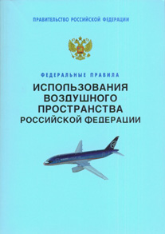
Air Code of the Russian Federation
Air Code of the Russian Federation
Federal Laws
Presidential Decrees
Government Resolutions
Federal Airspace Management Rules
Federal Aviation Rules

Slide 3
12579
12579
6228
2016
8 месяцев 2017

Slide 4
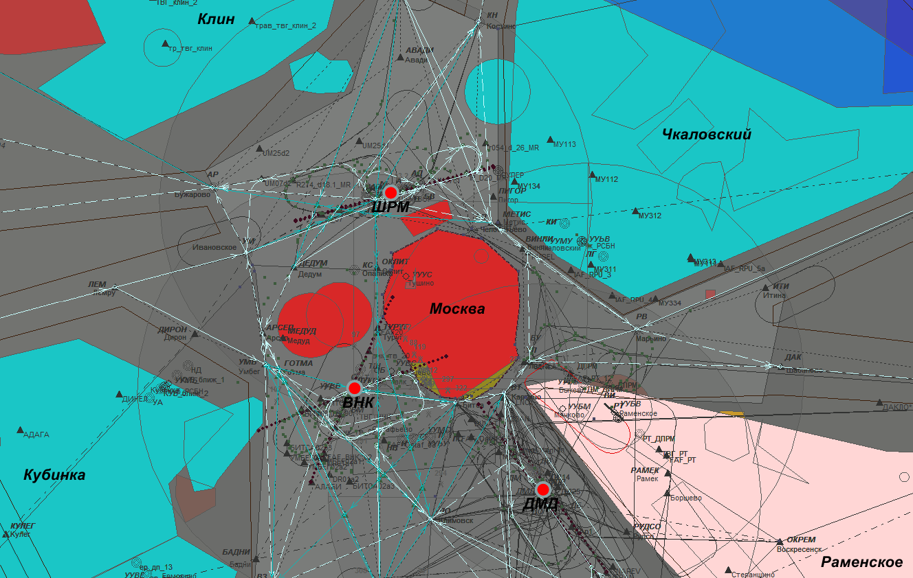
Temporary and Local Restricted Areas

Slide 5
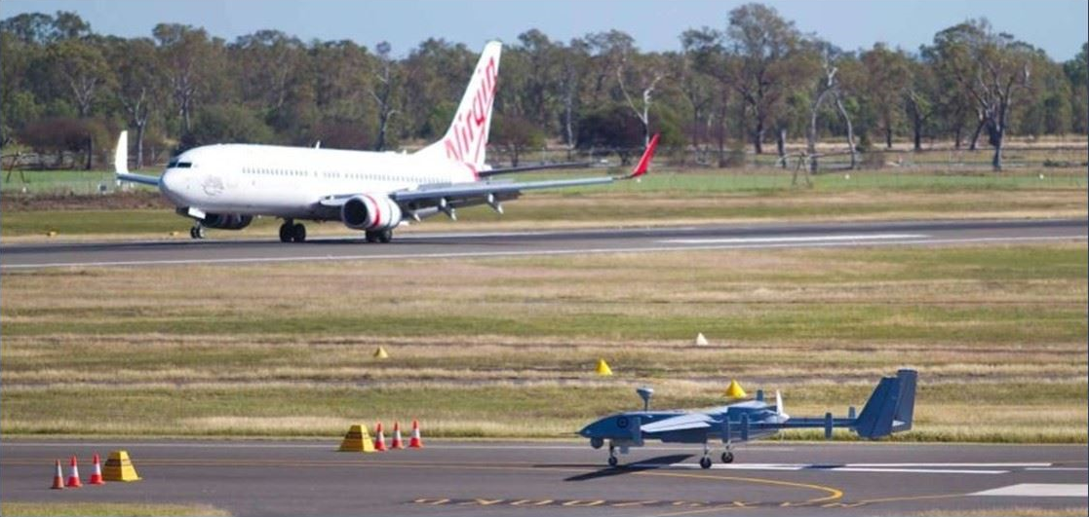
Simultaneous Operations

Slide 6
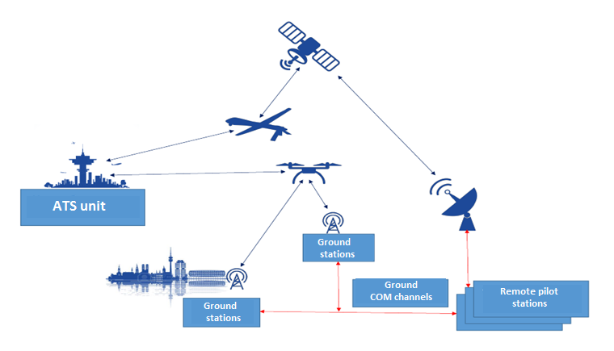
UAS Operations Control

Slide 7
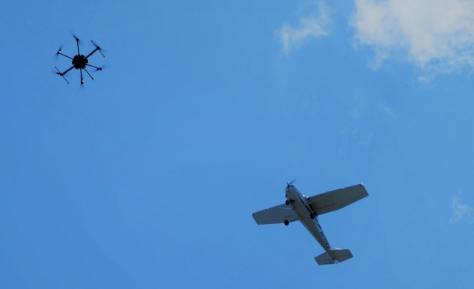
Thank you!

